Slide 1
MEC402 CHAPTER-1 Introduction to Casting-
Introduction, Historical development, Application, Advantages, Comparison with other manufacturing processes, Flow diagram for casting process. Procedures for sand casting and associated terminologies.
Dr. J.De

Slide 2
Introduction
Casting is a manufacturing process by which a molten material such as metal or plastic is introduced into a mold, allowed to solidify within the mold, and then ejected or broken out to make a fabricated part.
Casting may be used to form hot, liquid metals or melt-able plastics (called thermoplastics), or various materials that cold set after mixing of components such as certain plastic resins like epoxy, water setting materials.
Study on different casting process, their unique characteristics and suitability on different material and product specification will enhance the intelligent and broader use of casting in engineering production.

Slide 3
Casting is used for making parts of different shape that would be difficult or uneconomical(complex part) to make by other methods, such as material removal from solid material.
Foundry- commercial establishment for production of casting.
Wrought metal product differ from cast in the sense that wrought metal can be plastically worked like rolling, forging etc.
Types of iron-pig iron(3-4%c), wrought iron(.02-.03%c , pure iron and silicate slag),malleable iron(2-3%c with heat treatment), nodular iron(ductile ci) ,grey iron(2.5-3.8%c, si,fe), white iron(not machinable) etc.
Historical development
Oldest branch of engineering
Practiced in 4000BC- Cu arrowhead production
Bronze age 2000BC had more refinement of earlier product
Lot of cast product of bronze and copper were seen in indus civilization
Qutab minar uses casting with malleable iron and almost rustfree till date.
Rate of development not as per other branches of engg.
Initially it was treated as art
Shifted from art to engineering gradually due to development of other branches.
Computer aided design and analysis enhance accuracy and effectiveness of the process.

Slide 4
Application
Cast iron and aluminium take hold major share of engineering material
Automobile engine cylinder and other body parts like brake systems,power steering system, fuel intake parts and so many
Casting is used in transportation, construction, agricultural, aerospace, power generation and even nuclear field of engineering.
Hydroelectric machine parts, mill housing, machine tool bed
Impeller and other components Valves,Swirl Nozzles, Engine Blades, Engine Rings, Vanes
Aircraft fluid management systems, Interior components, Flight critical and safety components
Hydraulic fluid system components

Slide 5
ADVANTAGES
INTRICATE SHAPES- automobile engine cylinder blocks which have internal water jacket around the cylinder can be developed as liquid metal can flow at any space. Although certain limitation exists.
HEAVY AND BULKY PARTS- heavy parts are difficult to produce by other processes can be easily formed by casting (specially by pit moulding). Example- ball mill housing, machine tools bed and structuires.
WIDE RANGE OF MATERIAL- different materials like ferrous, non-ferrous like aluminium, manganese, magnesium and other types of alloy like brass, bronze can be easily cast.
TOOLS AND EQUIPMENT- simple and cheap. Tools can be easily mechanized. So job production to mass production is not a major issue
INTEGRATED PART DEVELOPMENT-some shape needs a number of steps to develop by other processes or may be joined or assembled to make a product. Casting eliminates those, as a result integrated part can be developed with better material properties.
GOOD MECHANICAL AND METALLURGICAL PROPERTIES- i) uniform directional property in all direction (ii) improved machinability and damping properties (iii) material possessing high strength/weight ratio is easily cast due to their low melting point.
SPECIFIC MATERIAL- some material cannot be hot worked, they can be only cast.
DISADVANTAGES
Rough surface finish, wide variation in dimension
For defect free casting, every steps are to be monitored and controlled skillfully.

Slide 6
COMPARISON WITH OTHER PROCESSES
CASTING
FORGING | DIRECTIONAL PROPERTIES IS HIGHLY AFFECTED IN WROUGHT MATERIAL AS DEFORMATION OCCURS AT ATOMIC LEVEL IN SOLID STATE ALONG DIRECTION OF APPLIED FORCE. CRYSTAL OR GRAIN ELONGATED IN METAL FLOW DIRECTION. | BETTER STRENGTH AND TOUGHNESS ACHIEVED AS THE GRAIN ARE ABLE TO OFFER MORE RESISTANCE TO STRESS.
WELDING | JOINING OF TWO OBJECTS, NOT AN INTEGRATED PART. It suffers from anisotropy i.e component has strength and ductility in working direction but lower transverse properties.
MACHINING | WASTAGE OF MATERIAL AS SCRAP. | ENSURE GOOD ACCURACY AND FINISH

Slide 7
CAPABILITIES OF CASTING Dimensions- larger in sand casting any size smaller 1mm. Tolerances- 0.125mm -2.5mm surface finish- die casting 1-3μm sand casting-2.5-25μm
TYPES
Sand casting 50% Expendable mould multiple use pattern
Shell 6% Expendable mould
Ceramic Expendable mould
Plaster Expendable mould
Lost foam Expendable mould expendable pattern
Pressure Expendable mould
Vacuum Expendable mould
Investment 7% Expendable mould
Die 9-12% multiple use mould
Centrifugal 7% Expendable mould
Squeeze Expendable mould
Slush multiple use mould
Contionous- 11% multiple use mould

Slide 8
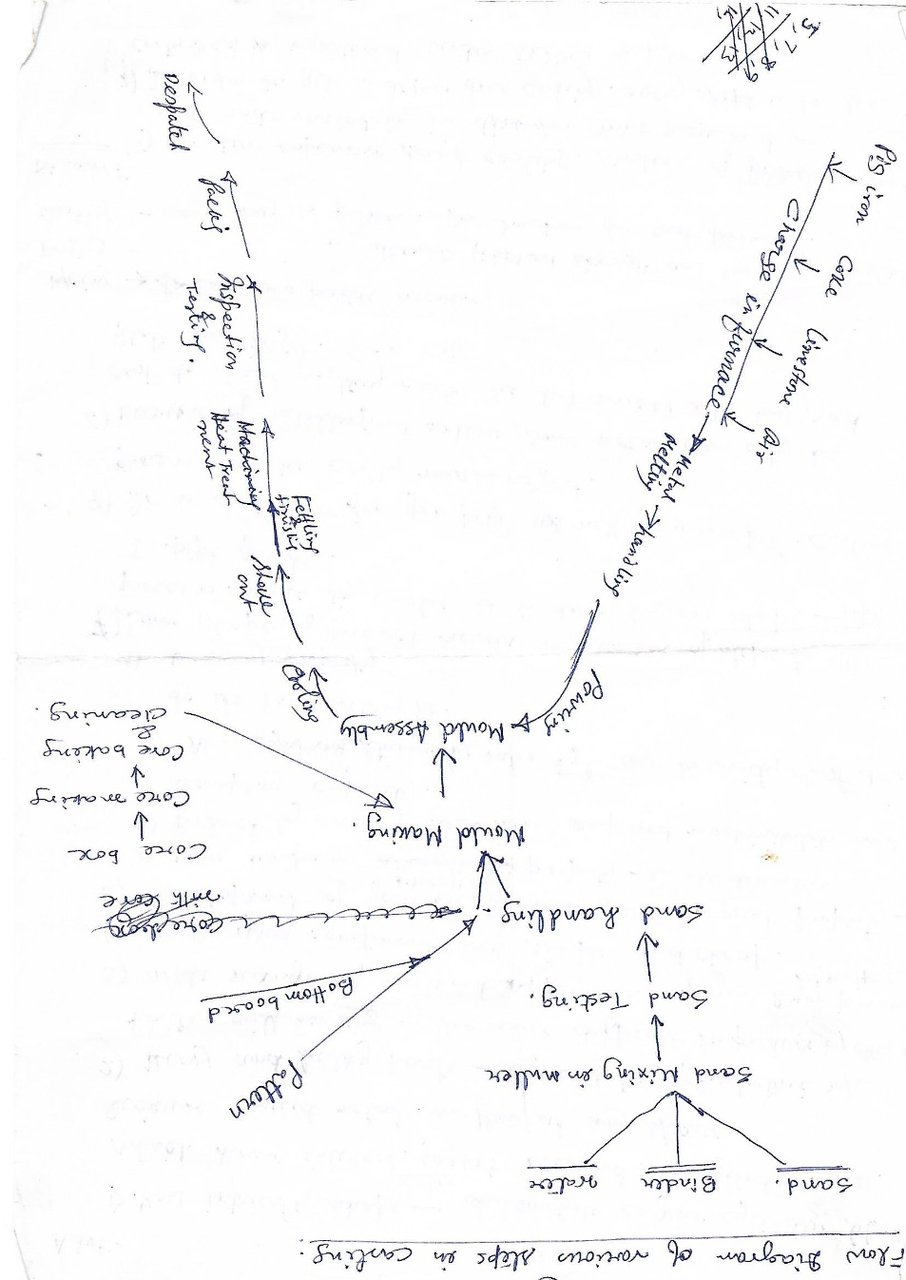
Flow diagram of various steps involved in sand casting Basic factors influence casting –(i) mould cavity(ii)melting process (iii) pouring technique (iv)solidification (v)part removal (vi) post processing

Slide 9
Steps involved in sand casting
1. Drag portion of pattern is placed in flask
The diagrams shows the pattern on a flat board and a casting box called a ‘drag’ being placed over it.
2. Drag is packed with sand-
Special casting sand will soon be packed around the pattern.To ensure the easy removal of pattern from the sand, facing sand is sprinkled over and around it. (parting powder is similar to talcum powder).It stops the casting sand sticking to the pattern and pulling away with it when the pattern is finally removed from the sand. This sand is subjected to max thermal load, so should have high strength and refractoriness and fine to ensure better surface. It is mixture of pure sand and clay.
Parting sand is spread over top of bottom board on which pattern is placed. Parting sand is dry sand, free of clay.

Slide 10
3. Packing of sand with ram-
The drag is then packed with more casting sand. It is a good idea to sieve all the sand being placed above the pattern and then ram it down firmly using a ramming tool.The tool has two ends,Cylindrical (used for general packing down of the sand) Pointed (Used for packing sand close up to the pattern).
4. Levelling- When the drag is packed fully it is leveled off (called ‘strickled off’) using a straight steel bar
5. Turn over drag- The entire drag and its contents are then turned over so that the base of the pattern can be seen.
6. Fixing and positioning of locating pins- top box called a ‘cope’ is then placed on top of the drag and locating pins are put in position so that the casting boxes cannot move sideways

Slide 11
7. Insert sprue and risers- Sprue pins are positioned. One usually on the back of the pattern and the other to the side. These will eventually provide an entrance and exit for the molten metal when it is poured into the sand. The sand is packed/rammed into the cope in the same way as the drag. Parting powder is first applied, followed by facing sand. The sprue pins should be taller than the box and stand out from the sand when it is leveled with a strickling bar. 8. Pack the cope with sand- Small depressions are dug into the sand at the top of the wo sprue pins. These are useful when the molten metal is poured. The depressions are called the pouring basin and feeder 9. Cutting of gates and runners- The top box (the cope) is then removed and if all is well the cope with the sand inside should lift off the drag (bottom box) without the sand falling out. A small ‘gate’ is cut below the position of one of the sprue pins. This will help the molten metal flow into the cavity left by the mould. Small tools are available or can easily be made to dig a variety of shapes in the casting sand.

Slide 12
10. Pattern removal- The pattern is removed using a ‘spike’. The end of the spike can be threaded and so it can be screwed into the softwood pattern. Before removing the pattern it is a good idea to gently tap the spike so that it loosens the pattern from the sand. It can then be lifted away from the casting box (drag). 11. closing of cope and drag- The cope (top casting box) is placed back on top of the drag and the locating pins put in position. Before this is done vents can be created using a thin piece of welding rod, pushing it through the sand . This allows gases to escape once the is poured. 12. pouring of molten metal- The molten metal is poured down the hole left by the first sprue pin (now called the ‘runner’). As it runs down the runner it flows through the ‘gate’ cut by the trowel, into the cavity left by the pattern and up the riser.

Slide 13
Pattern core and core print mould cavity cope and drag pouring basin-sprue- runner-gate choke riser vent parting line

